Slide 1
HYDRAULICS & HYDRAULIC MACHINES

Slide 2
Unit 8: DIMENSIONal ANALYSIS & model studies

Slide 3
Learning Outcome
In this unit, you will
Understand dimensions, units, and dimensional homogeneity
Understand benefits of dimensional analysis
Know how to use the method of repeating variables
Understand the concept of similarity and how to apply it to experimental modeling

Slide 4
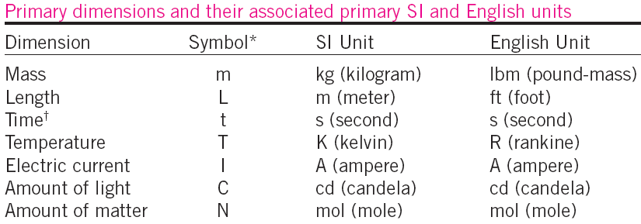
DIMENSIONS AND UNITS
A dimension is a measure of a physical quantity (without numerical values), while a unit is a way to assign a number to that dimension.
Note: All nonprimary dimensions can be formed by some combination of the seven primary dimensions.

Slide 5
Law of DIMENSIONAL HOMOGENEITY
Every additive term in an equation must have the same dimensions. For example,

Slide 6
DIMENSIONAL HOMOGENEITY
An equation that is not dimensionally
homogeneous is a sure sign of an error.

Slide 7
Nondimensionalization of Equations
Dimensional homogeneity ⇒ every term in
an equation has the same dimensions.
nondimensional ⇒ divide each term in the equation by
a collection of variables and constants whose
product has those same dimensions.
If the nondimensional terms in the equation are of order
unity ⇒ called normalized.
Normalization is thus more restrictive than nondimensionalization. (often used interchangeably).
Nondimensional parameters are named after a notable scientist or engineer (e.g., the Reynolds number and the Froude number). This process is referred to by some authors as inspectional analysis.

Slide 8
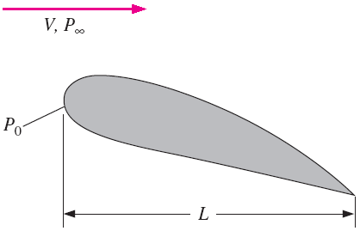
Nondimensionalization of Equations
To nondimensionalize equation, we need to select scaling parameters (Usually chosen from dimensional constants), based on the primary dimensions contained in the original equation.
In fluid flow problems there are
typically at least three scaling parameters, e.g., L, V, and P₀ - P∞, since there are at least three primary dimensions in the general problem (e.g., mass, length, and time).

Slide 9
SIMILITUDE – TYPES OF SIMILARITY
Nondimensionalization of an equation is useful only when the equation is known!
In many real-world flows, the equations are either unknown or too difficult to solve.
Experimentation is the only method of obtaining reliable information
In most experiments, geometrically–scaled models are used (time and money).
Experimental conditions and results must be properly scaled so that results are meaningful for the full-scale prototype. Therefore,
Dimensional Analysis

Slide 10
DIMENSIONAL ANALYSIS AND SIMILARITY
Primary purposes of dimensional analysis
To generate non-dimensional parameters that help in the design of experiments (physical and/or numerical) and in reporting of results.
To obtain scaling laws so that prototype performance can be predicted from model performance.
To predict trends in the relationship between parameters.

Slide 11
Principle of similarity
Three necessary conditions for complete similarity between a model and a prototype.
Geometric Similarity – the model must be the same shape as the prototype. Each dimension must be scaled by the same factor.
Kinematic Similarity – velocity as any point in the model must be proportional by a constant scale factor.
Dynamic Similarity – all forces in the model flow scale by a constant factor to corresponding forces in the prototype flow.
Complete Similarity is achieved only if all 3 conditions are met. This is not always possible, e.g., ship models.

Slide 12
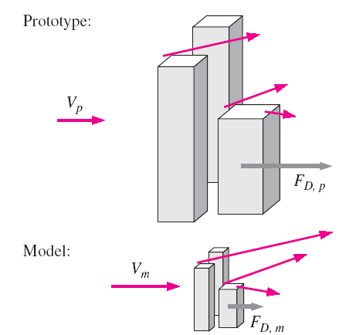
Principle of similarity

Slide 13
DIMENSIONAL ANALYSIS AND SIMILARITY
Complete similarity is ensured if the model and prototype must be geometrically similar and all independent Π groups are the same between model and prototype.
What is Π ?
We let uppercase Greek letter Π denote a nondimensional parameter, e.g., Reynolds number Re, Froude number Fr , Drag coefficient, C_{D}, etc.
In a general dimensional analysis problem, there is one Π that we call the dependent Π, giving it the notation Π₁. The parameter Π₁ is in general a function of several other Π’s, which we call independent Π’s. The functional relationship is

Slide 14
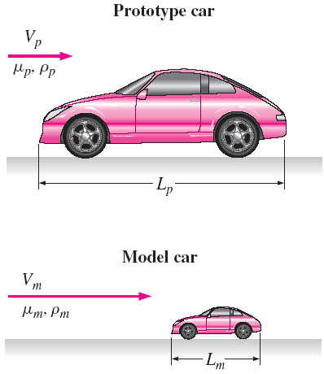
DIMENSIONAL ANALYSIS AND SIMILARITY
Consider automobile experiment
Drag force is F = f (V, ρ, µ, L)
Through dimensional analysis, we can reduce the problem to
where
= C_{D}
and
=Re
The Reynolds number is the most well known and useful dimensionless parameter in all of fluid mechanics.

Slide 15
Method of Repeating Variables
Nondimensional parameters Π can be generated by several methods.
We will use the Method of Repeating Variables popularized by Edgar Buckingham (1867–1940) and first published by the Russian scientist Dimitri Riabouchinsky (1882–1962) in 1911.
Six steps
List the parameters in the problem and count their total number n.
List the primary dimensions of each of the n parameters
Set the reduction j as the number of primary dimensions. Calculate k, the expected number of Π’s, k = n − j (Buckingham Pi theorem).
Choose j repeating parameters.
Construct the k Π’s, and manipulate as necessary.
Write the final functional relationship and check algebra.

Slide 16
Method of Repeating Variables
Step 1: List relevant parameters.
z = f (t,w₀, z₀, g) ⇒ n = 5
Step 2: Primary dimensions of each parameter
Step 3: As a first guess, reduction j is set to 2 which is the number of primary dimensions (L and t). Number of expected Π’s is k = n − j = 5 − 2 = 3
Step 4: Choose repeating variables w₀ and z₀

Slide 17
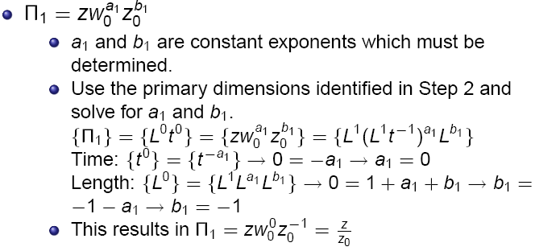
Method of Repeating Variables
Step 5: Combine repeating parameters into products with each of the remaining parameters, one at a time, to create the Π’s.

Slide 18
Method of Repeating Variables
Step 6:
Double check that the Π’s are dimensionless. Write the functional relationship between Π’s.
Or, in terms of nondimensional variables,
Overall conclusion: Method of repeating variables properly predicts the functional relationship between dimensionless groups.
However, the method cannot predict the exact mathematical form of the equation.

Slide 19
Guidelines for choosing Repeating parameters
Never pick the dependent variable. Otherwise, it may appear in all the Π’s.
Chosen repeating parameters must not by themselves be able to form a dimensionless group. Otherwise, it would be impossible to generate the rest of the Π’s.
Chosen repeating parameters must represent all the primary dimensions.
Never pick parameters that are already dimensionless.
Never pick two parameters with the same dimensions or with dimensions that differ by only an exponent.
Choose dimensional constants over dimensional variables so that only one Π contains the dimensional variable.
Pick common parameters since they may appear in each of the Π’s.
Pick simple parameters over complex parameters.

Slide 20
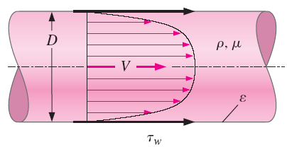
EXAMPLE: Friction in a Pipe
Consider flow shown in Fig.; V is the average speed across the pipe cross section. The flow is fully developed, which means that the velocity profile also remains uniform down the pipe. Because of frictional forces between the fluid and the pipe wall, there
exists a shear stress t_{w} on the inside pipe wall. The shear stress is also constant down the pipe in the region. We assume some constant average roughness height, ε, along the inside wall of the pipe. In fact, the only parameter that is not constant down the length of pipe is the pressure, which must decrease (linearly) down the pipe in order to “push” the fluid through the pipe to overcome friction. Develop a nondimensional relationship between shear stress t_{w} and the other parameters in the problem.

Slide 21
EXAMPLE: Friction in a Pipe
Solution
⇒

Slide 22
INCOMPLETE SIMILARITY ⎯ FLOWS WITH FREE SURFACES
For the case of model testing of flows with free surfaces (boats and ships, floods, river flows, aqueducts, hydroelectric dam spillways, interaction of waves with piers, soil erosion, etc.), complications arise that preclude complete similarity between model and prototype.
For example, if a model river is built to study flooding, the model is often several hundred times smaller than the prototype due to limited lab space. This may cause, for instance,
Increase the effect of surface tension
Turbulent flow ⇒ laminar flow
To avoid these problems, researchers often use a distorted model in which the vertical scale of the model (e.g., river depth) is exaggerated in comparison to the horizontal scale of the model (e.g., river width).

Slide 23
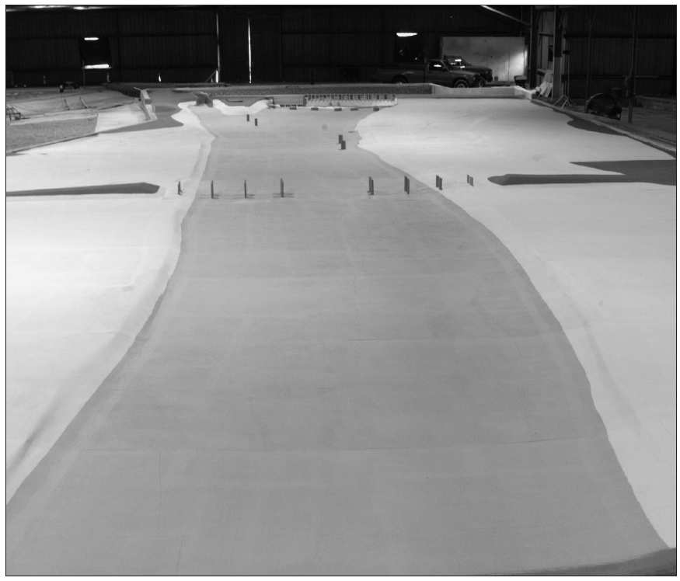
INCOMPLETE SIMILARITY ⎯ FLOWS WITH FREE SURFACES

Slide 24
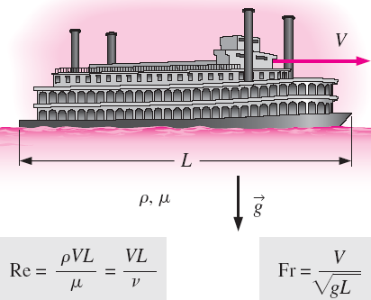
Incomplete Similarity ⎯ Flows with Free Surfaces
In many practical problems involving free surfaces, both the Reynolds number and Froude number appear as relevant independent Π groups in the dimensional analysis.
It is difficult (often impossible) to match both of these dimensionless parameters simultaneously.

Slide 25
Incomplete Similarity ⎯ Flows with Free Surfaces
For a free-surface flow, the Reynolds number and Froude number are matched between model and prototype when
and
To match both Re and Fr simultaneously, we require length scale factor L_{m}/L_{p} satisfy
⇒
From the results, we would need to use a liquid whose kinematic viscosity satisfies the equation. Although it is sometimes possible to find an appropriate liquid for use with the model, in most cases it is either impractical or impossible.

Slide 26
Problems
1. A pipe of diameter 1.5 mis required to transport an oil of sp.gr. 0.9 and viscosity 0.03 poise at the rate of 3000litres /s. Tests were conducted on a 15cm diameter pipe using water at 20ºC. Find the velocity and rate of flow in the model. Viscosity of water at 20ºC = 0.01poise.
2. Water is flowing through a pipe of diameter 30cm at a velocity of 4m/s. Find the velocity of oil flowing in another pipe of diameter 10cm if the conditions of dynamic similarity is satisfied between the two pipes. The viscosity of water and oil is given as 0.01 poise and 0.025 poise respectively. The specific gravity of oil = 0.8

Slide 27
Questions
1.Define the term dimensional analysis and model analysis
2. What do you mean by fundamental units and derived units
3. Explain the methods of dimensional analysis briefly
4. What is meant by repeating variables? How are the repeating variables selected for dimensional ?
5. Define the terms : model, prototype, model analysis

